Slide 1
Blokus with AI
Thomas Mallinson, Jacob Peterson, Prasanna Gnanasekaran

Slide 2
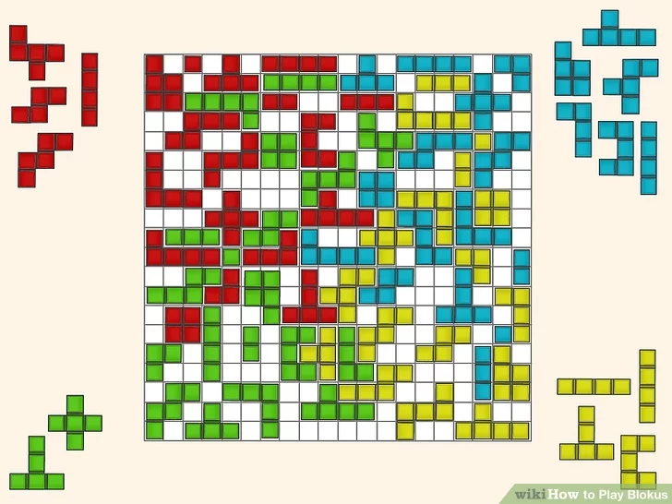
Introduction/Overview
Goal of the project - Simply study of heuristics. Taken a strategy board game and implemented it with heuristics.
For our measurement of success we account for the score in the game rather than the run time.
Only data our project requires is the sizes and shaped and shapes of the pieces from the Board game.

Slide 3
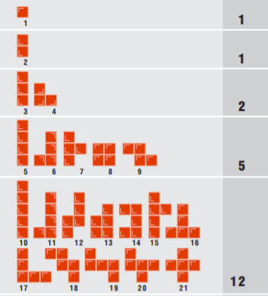
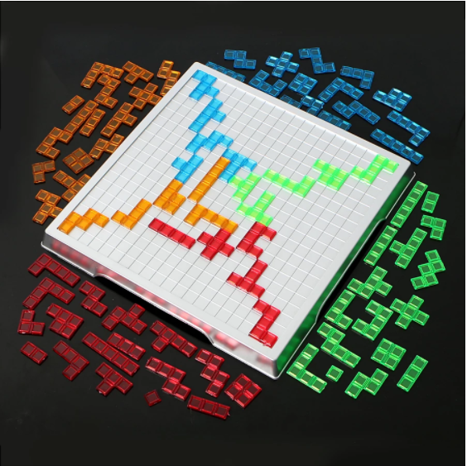
Background
How to Play the Game?
There can be up to 4 players and each player chooses a color and gets all their 21 pieces.
The first piece placed by each player must cover a corner square on the game board.
Next, each new piece placed must touch at least one other piece of the same color, but only at the corners and not along the edge.
There are no rules on how the pieces of different colors may contact each other. Once the piece is placed on the board it cannot be moved for the other turns.
The game comes to an end when a player has placed all their 21 pieces on the game board or if all the players are blocked from putting down anymore of their pieces.

Slide 4
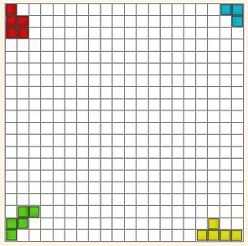
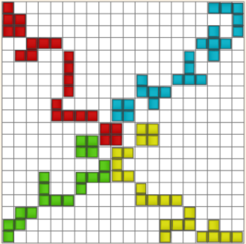
Background
Different heuristic approaches:
Random
Greedy
Center of the board control
Corner management

Slide 5

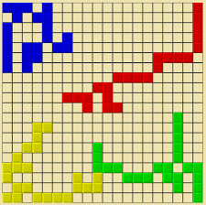
Methodologies
We utilized the following within our project:
Python Standard Library
Google Colaboratory
Blokus Duo vs. Blokus
Board stored as character array

Slide 6
Creating the Project

Slide 7
Approaching the Project
Wanted a unique board game with a complexity more similar to Chess than Checkers
Four player Blokus
Researched game rules and basic strategies
Collected sources that would aid us in developing the code, such as GitHub, Google Scholar, AI Textbooks
Created outline of code, started building
Implement additional agents as we thought of strategies to try

Slide 8
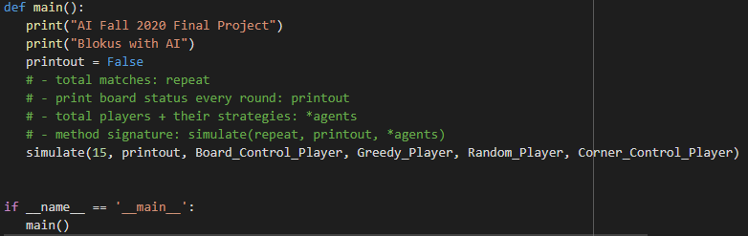
Overview of Code
Basic Outline of Our Code:
Create board
Create pieces
Create parameters for legal moves
Develop way to get all possible moves
Create four different AI agents
Check if there is a winner for the game
Print results
Notes:
Legal moves parameters: must start in corners, cannot overlap, must be within the boards bounds, check if it’s already occupied
Possible moves rotates and flips pieces to see if they’re valid anywhere
We will quickly demo this later

Slide 9
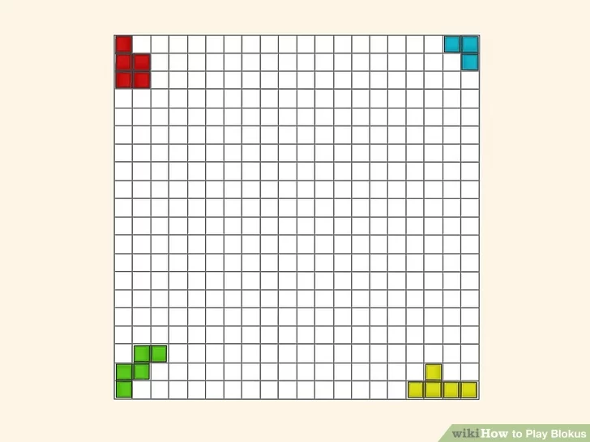
Creating the Board
The board is defined within a class as a 20x20 2-d array.

Slide 10
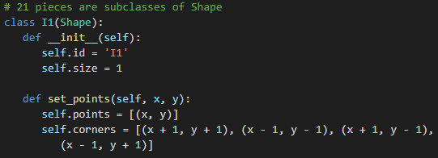
Creating the Pieces
Each possible piece was created within its own class.
The points and corners are created on a two-dimensional character array
Notes:
The 21 pieces available in the game of Blokus were all individually created in their own class.

Slide 11
Reward Functions
Our reward function was the total number of points scored added to a weighted number of wins. We chose 25 as our weight for the number of wins, to prioritize winning agents over high scoring agents:
Reward = total_points_scored + 25(total_wins)
Alpha-beta pruning wasn’t as easily implementable with a four-player game as opposed to a two-player game.
We did not reward for an optimized time-to-run route in our four-player Blokus game, so iterations took longer than if we were to use alpha-beta pruning.
Notes:
Focused on a strategy board game and implemented it with heuristics.
Two player games have a min and max

Slide 12
Agent Types

Slide 13
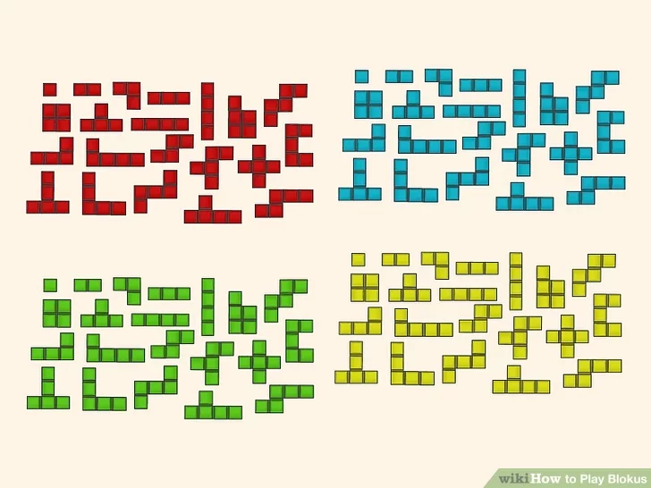
Random Agent
The random agent is designed to randomly select a piece from a list of all possible moves and to choose a random placement to utilize it.

Slide 14
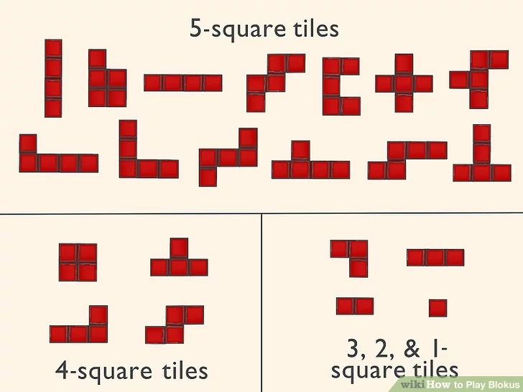
Greedy Agent
The Greedy Agent is designed to select the piece with the largest size out of the available pieces and to prioritize playing it first.
General game strategy suggests playing larger pieces before smaller pieces so you are left with more flexibility near the end of the game.

Slide 15
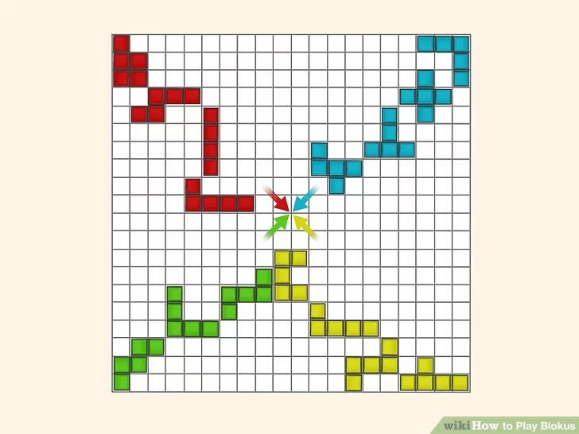
Center of the Board Control Agent
The Agent designed to control the center of the board weights pieces that can be played closest to the center of the board and takes into account their size as well.
Building towards the center of the board is a basic strategy that we researched in order to win games of Blokus against other people.

Slide 16
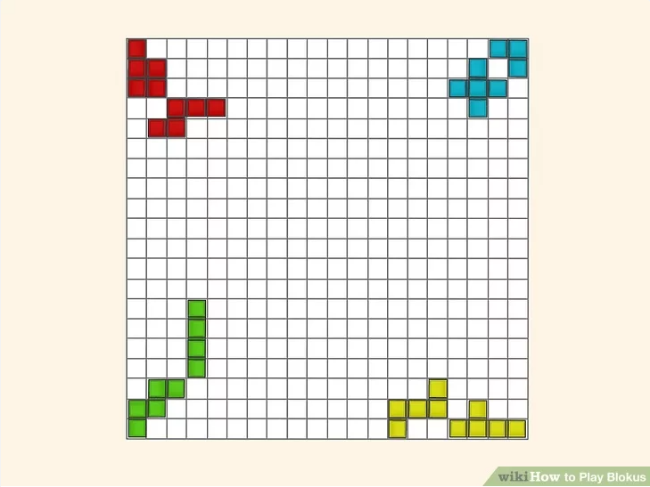
Corner Management Agent
The Corner Management Agent chooses an available piece based off a heuristic on the piece’s size and the total corner difference between that player and their opponents from its placement.
This agent does look one turn ahead into the game, whereas the other agents do not.
Notes:
It weights both the size and total corner difference between the player and opponent
Pseudo-minimax because it does take future moves into consideration

Slide 17
Code Demonstration
https://colab.research.google.com/drive/1PVjEBH3B0ip18Ua7nbnhUIAmTPSI-WM3

Slide 18
Results

Slide 19
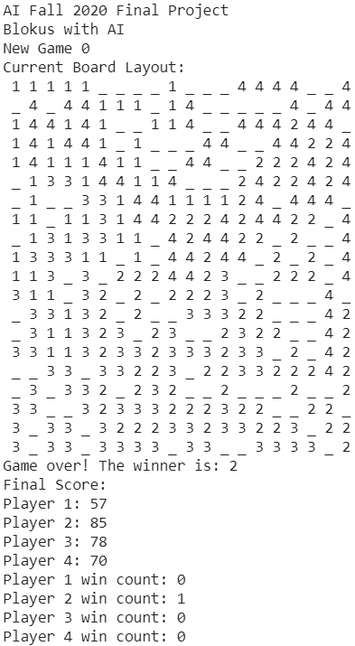
Simulations
We did 15 simulations between every iteration of the four agents we created to collect a large enough sample size to derive an answer to a hypothesis.

Slide 20
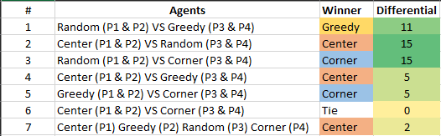
Results
The Center Management Agent was the highest performing agent that we designed. It broke even with corner management in the head to head games, but won more games in the 1 v 1 v 1 v1. The score differentials have been listed below, with full results compiled in the “Simulation Results” file

Slide 21
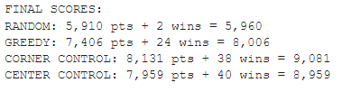
Results
Our reward function weighted wins heavily, so as a result, the corner control agent and center control agent greatly outperformed the random and greedy agents, with the random agent scoring almost half as many overall points. One interesting point of note is that the corner control agent scored more points overall in its games, but won fewer games and was thus deemed an overall worse performing agent.

Slide 22
Summary and Future Work

Slide 23
Findings/Challenges
Designed heuristics performed well
Center of board agent performed better against corner control agent when all four agents were present in the game
Speed challenges - simulations were quite costly
Large pool of possible moves, 4 agents and a dozen or more turns
No alpha-beta pruning
Turning strategies I have used myself into codable heuristics was the biggest take-away from this project

Slide 24
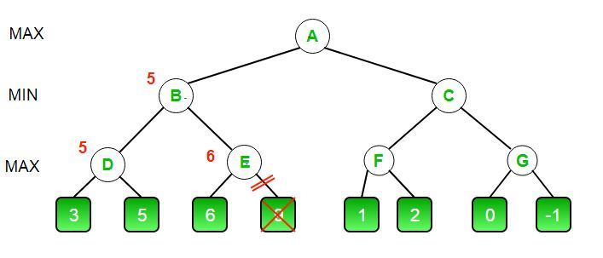
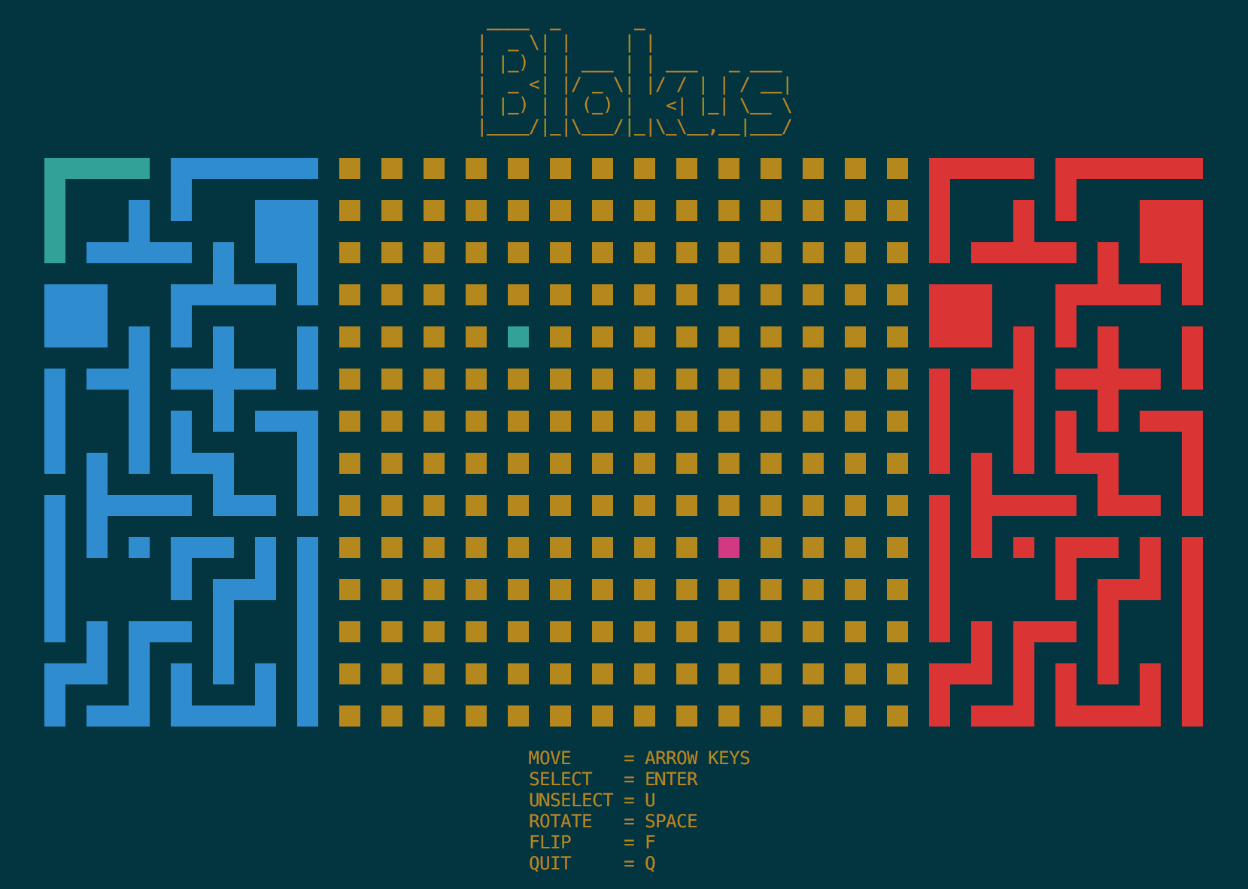
Future Implementations
Alpha beta pruning
Blokus Duo?
Other time saving/efficiency changes
Potential for human player would allow for us to gauge heuristic’s viability against intelligent human components
Visual upgrades
Colors
Menu
Graphical elements, rather than printing chars

Slide 25
Thank you!

